Slide 1

Correlation Analysis & Generalizing
W
E
E
K

Slide 2
Learning Outcomes:
1. Generalization (Ch 12)
Explain the concept of generalization and how it is used to estimate population values.
Estimate a Confidence Interval.
Test a Hypothesis.
Demonstrate the Generalize functions in XLDA.
2. Visuals & Data Analysis
Describe proper use of Visuals in research reporting.
Explain how Type of Question and Level of Measurement affects the Type of Analysis .

Slide 3
The Concept of Generalization
Recall …
Researchers draw sample because it is cheaper and faster than surveying the whole population.
Only a probability sample is representative of the target population.
A probability sample size is based on the amount of error that the manager can accept.

Slide 4
The Concept of Generalization
Sample finding is an estimate yet, with the right tools, we can generalize the sample finding to the total customer population.
For a probability sample we can generalize the findings to the total target population.
Ex: 20% of the sample intend to buy our brand within 3 months.
We therefore can expect that 20% of the target population intend to buy our brand within 3 months.

Slide 5
Population Fact
Population Fact: the true value when a census of the population is taken using all members of the population.
Population facts are rarely ever known.
Sample findings, are used to estimate population facts.

Slide 6
Sample Findings
Sampling Findings: values based on sample data.
Sample findings are expressed as values:
Percentage
Average
Other analysis value.
Sample findings are our best estimates of population facts though they always contain sample error.

Slide 7
Generalization
Generalization: is the act of estimating a population fact from a sample finding.
Definition: Generalization is a form of logic in which you make an inference about an entire group based on some evidence about that group.
When we generalize the results, we project the findings onto the entire target population.

Slide 8
Generalization
The stronger the evidence, the more confident you are about the generalizations.
The strength of the evidence is based on:
The sample size:
The larger the sample size, the greater the evidence.
The variability within the sample data:
The less the variability in the sample data, the stronger the evidence.

Slide 9

Symbols Used in Generalizing
Statisticians refer to population values as parameters.
Parameter estimation: the process of generalizing a sample’s finding to the population.
Based on research we can estimate how many minutes students study each day

Slide 10
Estimates
POPULATION
(Greek Letters):
π = percent
µ = average
SAMPLE
(Roman Letters):
p = percent
x = average

Slide 11
Confidence Interval

Slide 12
Confidence Interval
A range (lower and upper boundary) into which the researcher believes the population parameter falls with a degree of confidence.
Industry standard: 95% or 99%.

Slide 13
Confidence Interval
Understanding Level of Confidence
If you took many, many samples and plotted your percentage, your sampling distribution would look like a bell-shaped curve.
Notes:
13

Slide 14
Confidence Interval
Understanding Level of Confidence
95% of your percentages would fall between ± 1.96 times the standard error of the percentage.
We can say that we are 95% confident that the population percentage falls in the range.
The range is the confidence interval, and expressed as ± X%.
Notes:
14

Slide 15
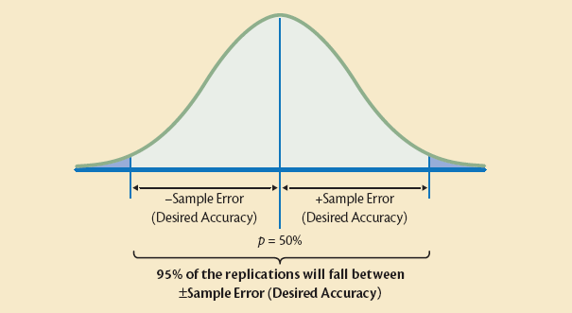
Confidence Interval
Notes:
Note: this example is for a calculated percent i.e., Categorical data.
Similar concept for Metric data

Slide 16
Calculating Confidence Interval
We know the sample finding contains sampling error.
We translate our sample findings into ranges: 40% ± 5%
percent ± error
p ± e
This example is for categorical data – using percent.
Similar concept for metric data – using average.

Slide 17
Calculating Confidence Intervals
The formula you use to calculate the Confidence Interval depends on the level of measurement:
Categorical data.
Metric data.

Slide 18
Confidence Interval for Categorical Data

Slide 19

Estimate a Population Percentage for Categorical Data
Ex: Random sample to measure the percentage of respondents ordering Egg McMuffins for breakfast at McDonald’s.
Q: did you order a McMuffin today? Yes / No
Data: Categorical.
Statistic: Percentage.
Notes:
Data: categorical (“yes,” ordered Egg McMuffin; “no,” did not order Egg McMuffin)
Appropriate summarization statistic: percentage for Categorical variable.

Slide 20

Confidence Interval: Categorical Data
Ordered McMuffin?
p: percent (Yes)
q: 100% – p (No)
p ± error
The size of the error depends on:
Variability: p * q
Sample size: n
Notes:
Z₉₅ = 1.96
Z₉₉ = 2.58
= 95% or 99%
S_{p} = Standard error (of percent)

Slide 21
Standard Error
The Standard Error of Percent is
Larger with more variability.
Smaller with large samples (n).

Slide 22
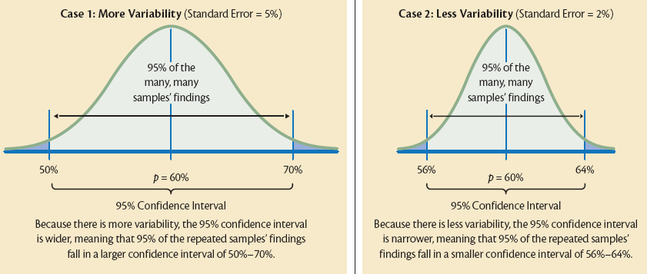
Variability & Sampling Distribution
The shape of the sampling distribution is a function of variability and sample size
Notes:
p ± error
p ± (1.96* s_{p}) where s_{p} = Standard Error (Percent)
Case 1:
60% ± (1.96*5%) ~ 60% ± 10% ~ 50% - 70%
Case 2:
60% ± (1.96*2%) ~ 60% ± 4% ~ 56% - 64%

Slide 23

Back to the Example …
Sample Finding: 30% ordered Egg McMuffin.
Level of confidence: 95%
Sample error: 5%
Confidence Interval: 30% ± 5%
Conclusion: we are 95% sure that the ‘true’ value is between 25% and 35%.
Generalization & Interpretation: we are 95% sure that 25% - 35% of the target population will order Egg McMuffins for breakfast at McDonald’s.
Notes:
23

Slide 24
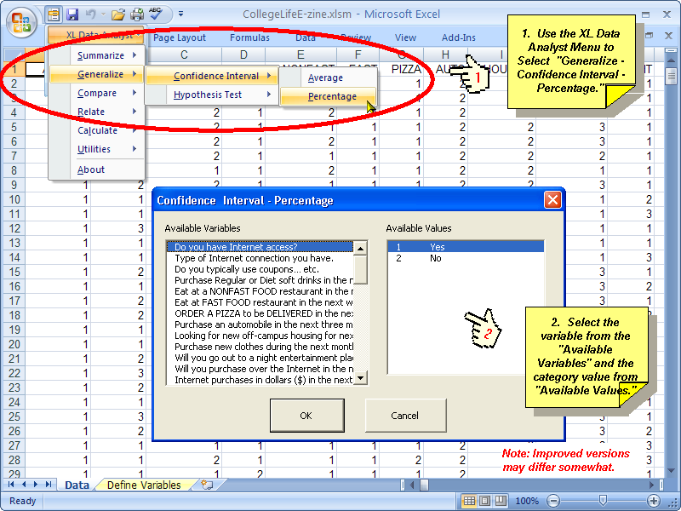
XLDA Confidence Interval: Percent

Slide 25
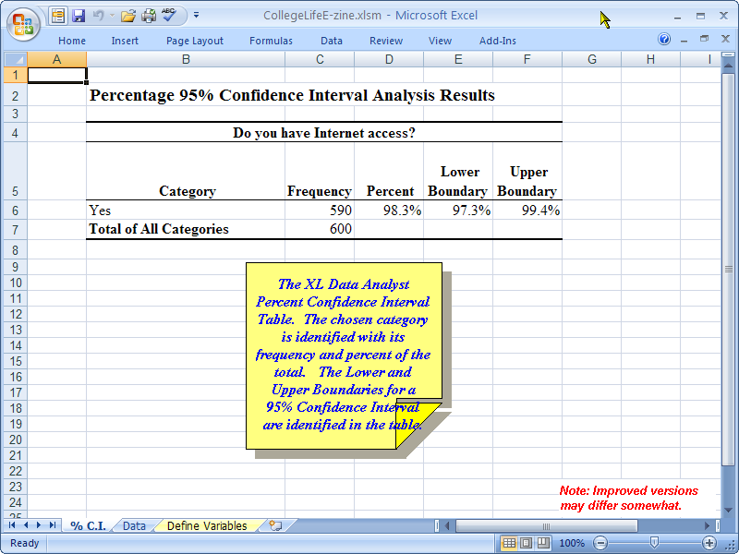
XLDA Confidence Interval: Percent
Confidence Interval
Summarize: Percent

Slide 26
Confidence Interval for Metric Data

Slide 27
Confidence Interval for Metric Data
The general principles of Confidence Interval that you have just learned for Categorical is the same for Metric data.
However, the formulas are different.

Slide 28

Estimate Population Average for Metric Data
Random sample to determine the average number of minutes readers spend reading the Vancouver Sun.
Q: How many minutes do you read the Vcr Sun per day?
Data: Metric.
Statistic: Average.
Notes:
Data are Metric (number of minutes)
Appropriate summarization statistic: Average for Metric variable.

Slide 29
Variability
Metric Data: Standard Deviation
Categorical Data: Variability.
For Metric Variables, we calculate the Standard Deviation along with the Average in the Summarizing command.

Slide 30
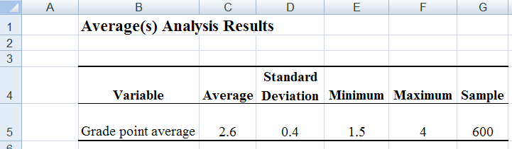
Standard Deviation
Standard Deviation:
Measures how spread out the data is.
Notes:
Measures how spread out the data is.

Slide 31


Confidence Interval: Metric Data
x ± error
Standard Deviation
1.96*
n
= Sample Average
The size of the error depends on:
Standard Deviation
Sample size: n
Notes:
Z₉₅ = 1.96
Z₉₉ = 2.58
= 95% or 99%
S_{x} = Standard error (of average)

Slide 32
Standard Error
The same logic is used here as with the standard error of the percentage.
The Standard Error of Average is
Larger with higher standard deviation (more variability).
Smaller with large samples (n).

Slide 33
Interpreting a Confidence
Interval Metric Data
If we conducted the survey many, many times and plotted the average number of minutes of reading the Vancouver Sun for each sample in a frequency distribution, it would look like a bell-shaped curve.

Slide 34
Interpreting a Confidence
Interval Metric Data
95% of the sample averages would fall in the confidence interval defined by the population average ± error.
This allows us to state that we are 95% confident that the true population average falls within the range calculated by our confidence interval.

Slide 35

Back to the Example …
Sample Finding: Average of 45 min.
Standard Deviation: 20 min.
Level of confidence: 95%
Confidence Interval: 41.1 – 48.9 min.
Conclusion: we are 95% sure that the ‘true’ is between 41.1 – 48.9 min.
Generalization & Interpretation: we are 95% sure that the target population spends 41.1 – 48.9 minutes reading the Vancouver Sun.
Notes:
35

Slide 36
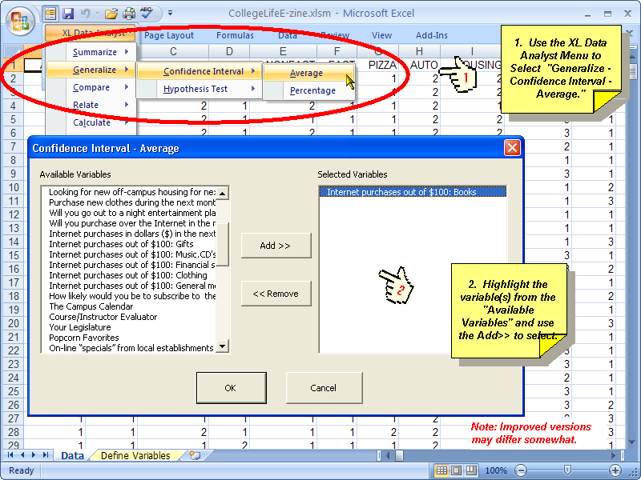
XLDA Confidence Interval: Percent
Notes:
36

Slide 37
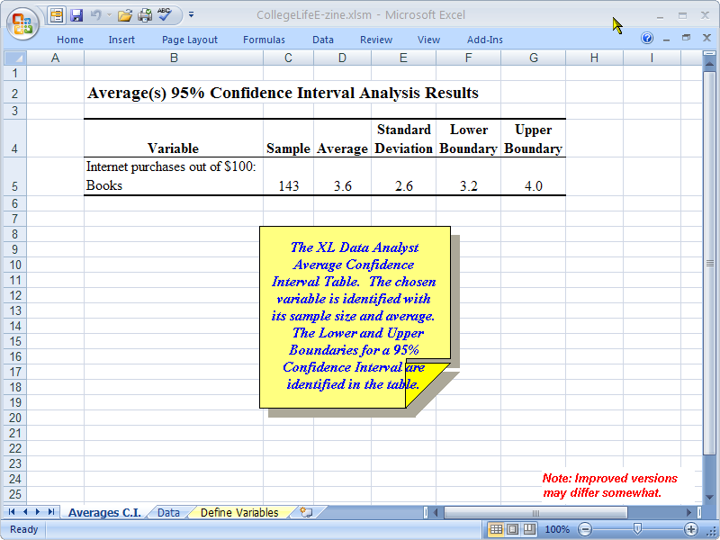
XLDA Confidence Interval: Percent
Confidence Interval
Summarize: Average & SD
Notes:
37

Slide 38
Testing Hypotheses

Slide 39
What is a Hypothesis?
Sometimes the marketing researcher or manager – client makes a statement about the population parameter based on prior knowledge, assumptions, or intuition.
This statement, called a hypothesis, most commonly takes the form of an exact specification as to what the population value is.

Slide 40

Hypothesis
When we form beliefs, gather evidence (findings) and make conclusions.
Example: Intuitive Hypothesis Testing
Bill doesn’t wear his seatbelt, and he thinks only 1/3 of people wear seatbelts [hypothesis].
Getting rides for a week with other drivers he observes that most wear seatbelts [findings].
Bill changed his beliefs and begins to wear a seatbelt [conclusion].

Slide 41
Testing Hypotheses about
Percents or Averages
Hypothesis Testing:
A statistical procedure used to “support” (accept) or “not support” (reject) the hypothesis based on sample information.
In essence, we are generalizing the findings into our beliefs so they are consistent with the findings.

Slide 42
Hypothesis Testing
Hypothesis testing uses sample data as the source of information about the population.
Hypothesis testing is only valid for a probability sample.
Sample results are used to determine whether or not the hypothesis about the population parameter has been supported.

Slide 43
Null Hypotheses
The Null Hypothesis H₀: is a formal statement that there is no (or null) difference between the hypothesized value and the percent value found in the sample.
Hypothesis Test: Compare the value we think (hypothesize) is the real population value with the sample value.

Slide 44

Null Hypotheses
Study BCIT students’ beer drinking behaviour.
From previous studies or observation, you believe (hypothesize) that 75% of BCIT students drink beer.
H₀: There is no difference between the sample findings and the hypothesized value of 75%.
H_{a}: There is a difference.

Slide 45
Hypothesis Testing
The formula you use for Hypothesis Testing depends on the level of measurement:
Categorical data.
Metric data.

Slide 46
Hypothesis Testing for Categorical Data

Slide 47

Hypothesis Testing about a Percent
If your variable is Categorical, the Percent is the appropriate summarization statistic.
Ex: “Do you typically use 2-for-1 specials and other promotions you see in magazines or newspapers?
Hypothesis: 50% say yes.
47
Notes:
47

Slide 48
Hypothesis Test about a Percent
p - π_{H}
z =
s_{p}
p = Sample percent
π_{H} = Hypothesized population percent
s_{p} = Standard Error of Percent

Slide 49
Hypothesis Test about a Percent
In the formula, the sample percent (p) is compared to the hypothesized population percent (π_{H}).
This difference is divided by the standard error to determine how many standard errors away from the hypothesized parameter the sample percentage falls.

Slide 50
Hypothesis Test about a Percent
IF the hypothesized value is in fact the real population value, we would expect 95% of our sample percentages to fall between ± 1.96 standard errors.
In other words, to support the hypothesis, we would expect z to fall between ± 1.96

Slide 51
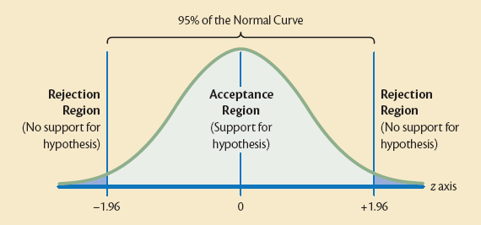
Acceptance and Rejection for Hypothesis Tests

Slide 52
Testing a Directional Hypothesis
Directional Hypothesis:
A hypothesis that indicates the direction in which you believe the population parameter falls relative to some hypothesized average or percentage.
You are testing “greater than” or “less than”…

Slide 53
Testing a Directional Hypothesis
To test Directional Hypotheses:
The sample percent or average must be in the right direction.
The critical z value is 1.64 (for the 95% level of confidence.
1.64 is used instead of 1.96 because we are using only one side of the bell-shaped curve in what is known as a one-tailed test.

Slide 54
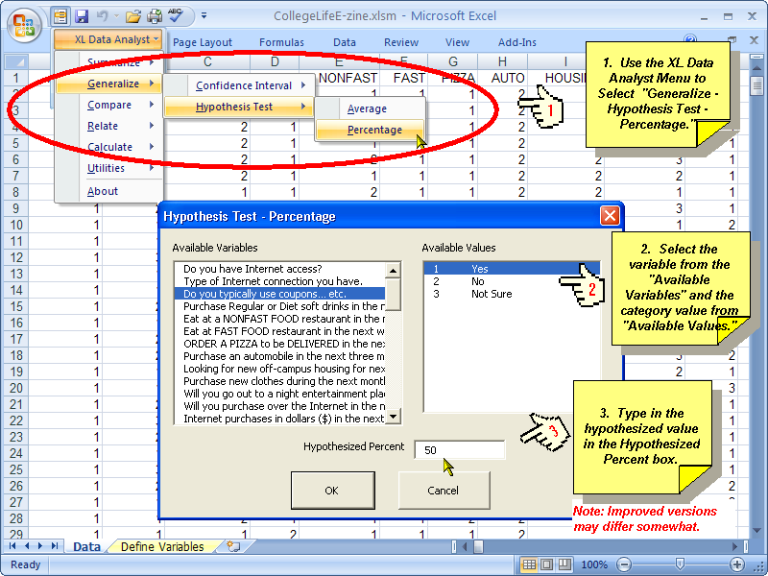
XLDA: Hypothesis Testing about a Percentage

Slide 55
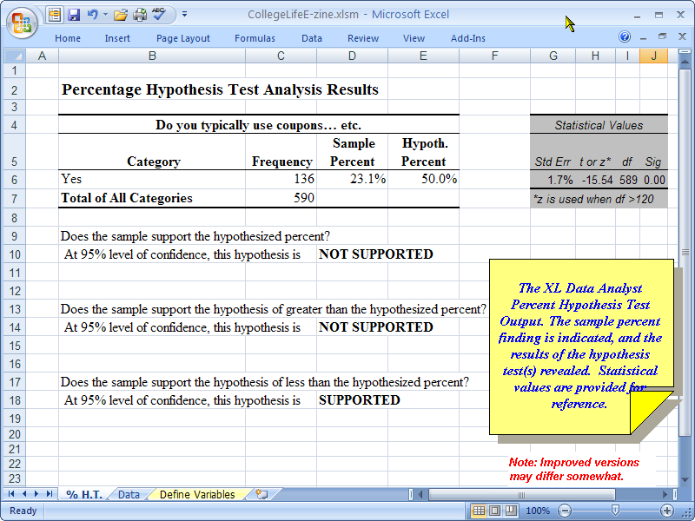
XLDA: Hypothesis Testing about a Percentage
You don’t need to know this

Slide 56
Hypothesis Testing for Metric Data

Slide 57

Hypothesis Test about a Average
If your variable is Metric, the Average is the appropriate summarization statistic.
The hypothesis testing follows same principle as with a percent, but the formula is different.
Q: How much money do you plan to spend on shopping over the Internet over the next 2 months?
57
Notes:
57

Slide 58
Hypothesis Test about an Average
x - u_{H}
z =
s_{x}
x = Sample average
u_{H} = Hypothesized population average
s_{x} = Standard Error of Average

Slide 59
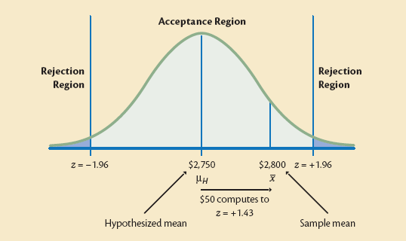
Testing a Hypothesis about
an Average

Slide 60
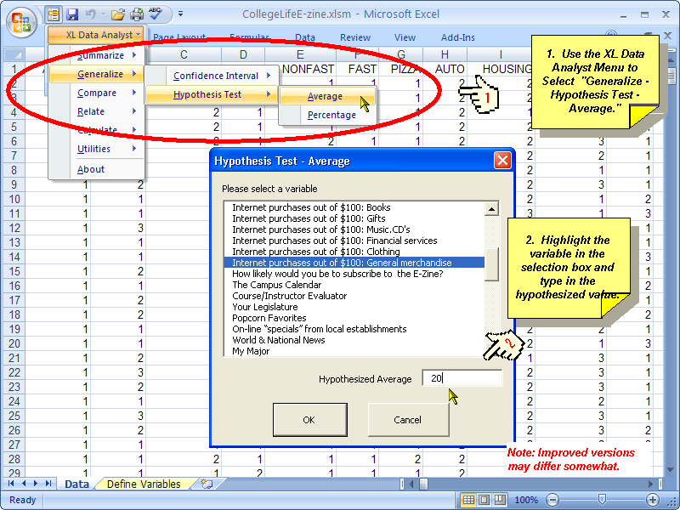
XLDA: Hypothesis Testing about an Average
Notes:
60

Slide 61
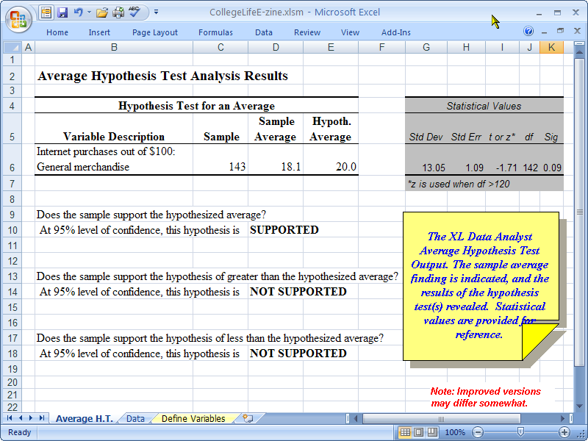
XLDA: Hypothesis Testing about an Average
You don’t need to know this
Notes:
61

Slide 62

We have covered a lot of technical stuff today …

Slide 63
Ch 12 Review!
Generalization:
With Probability Sample, we can generalize the sample findings to the target population.
Different formulas for Categorical and Metric data.
Testing a Hypothesis:
With Probability Sample, we can test a hypothesis against sample findings.
Different formulas for Categorical and Metric data.
Only relevant for
Probability samples!

Slide 64


Slide 65
Visual Display of Research Findings

Slide 66
Visuals in the Research Report
General Rule:
Use visuals in the body of the report.
Place tables in the Appendix.
Develop a style sheet for the group to follow:
Style of visuals, Labels, Titles, etc.
Fonts, font size.
Headings.

Slide 67
Visual Display of Research Findings
Diagrams
Graphs
Maps
Etc…
Visuals include:
Tables
Figures
Charts

Slide 68
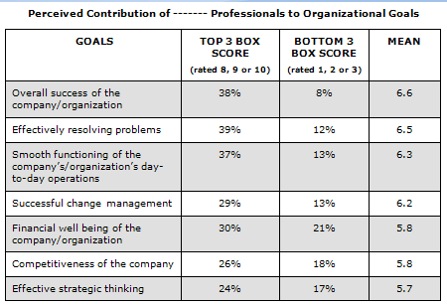
Tables
Tables identify exact values

Slide 69
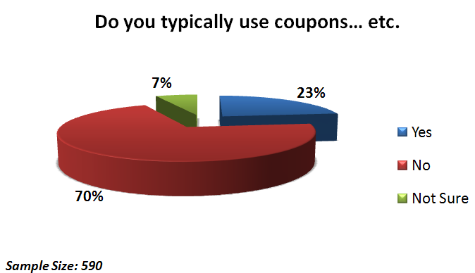
Pie Charts
Compare a specific part to the whole.
Max 4 answer categories.
Add data labels & legend

Slide 70
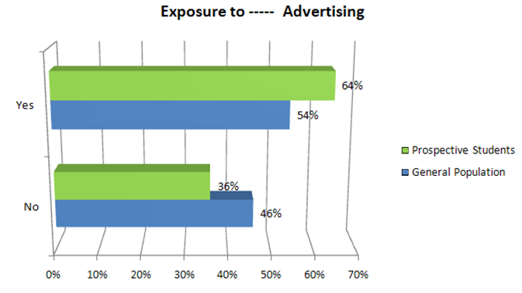

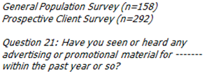
Bar/Column Charts
Show correlations between response categories.
Be careful with 3-D charts.

Slide 71
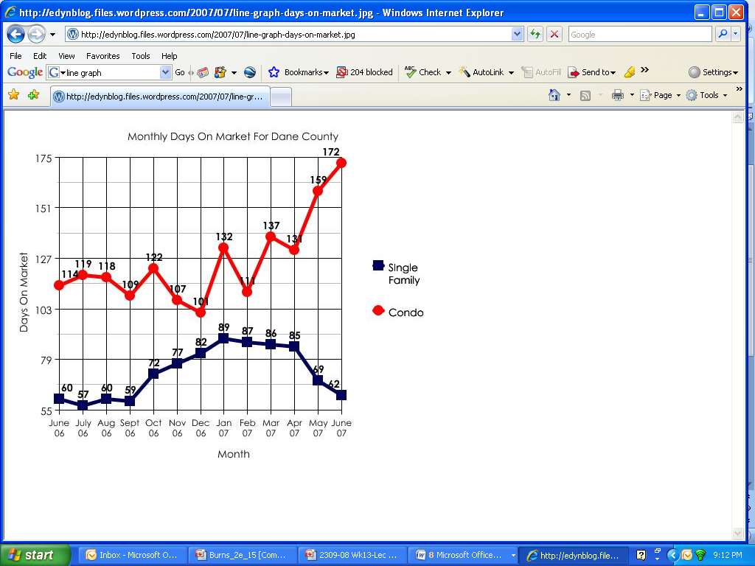
Line Graphs
Show changes in a variable over time as well as relationships between variables.

Slide 72
Flow Diagrams
Introduce a set of topics and illustrate their relationships.

Slide 73
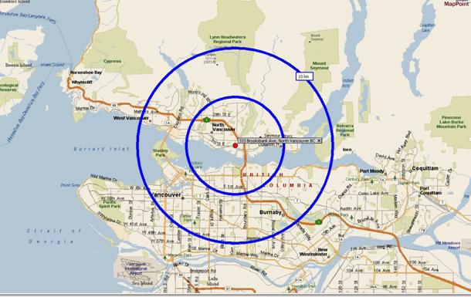
Maps
Define locations.
Show area size.

Slide 74
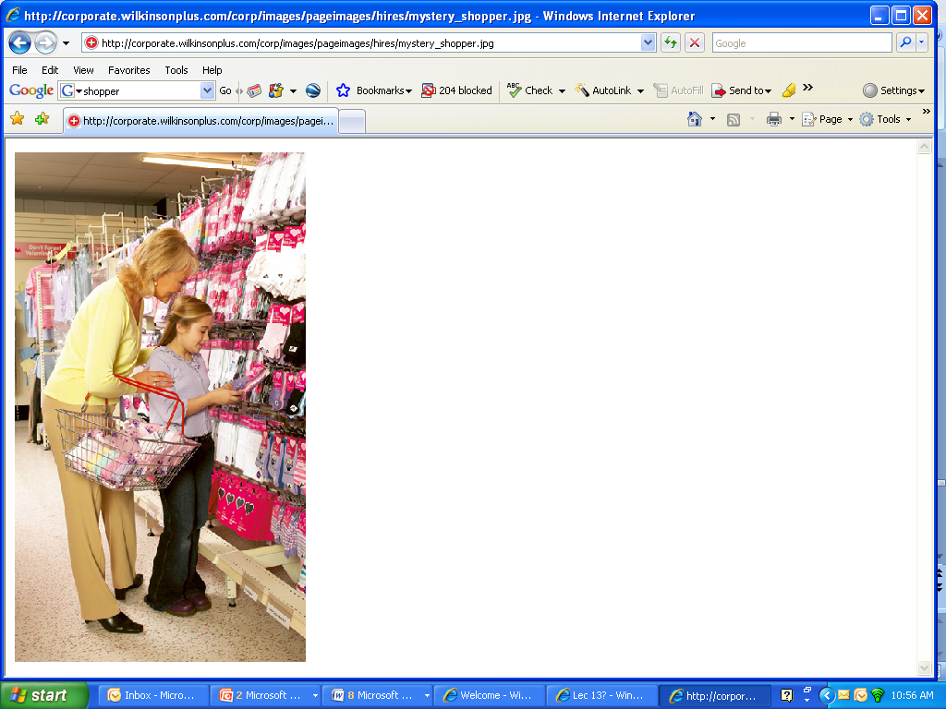
Photos
Present an aura of legitimacy because they are not “created” in the sense that other visuals are created.
Photos depict factual content…

Slide 75
Ethical Visuals
An ethical visual is one that is totally objective in terms of how information is presented in the research report.
Double- and triple-check all labels, numbers, and visual shapes.
Make sure all parts of the scales are shown.
Exercise caution if you use 3-D figures.

Slide 76
Components of Charts

Slide 77
Required Components
Edit Title
Specify
the scale
Data
Values
Sample
Size
Illustrate relationships among items.
Compare averages.

Slide 78
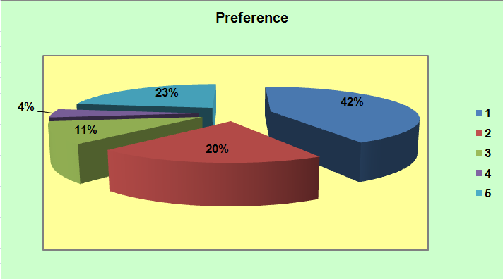
What should be improved?
Too many categories for a pie chart.

Slide 79
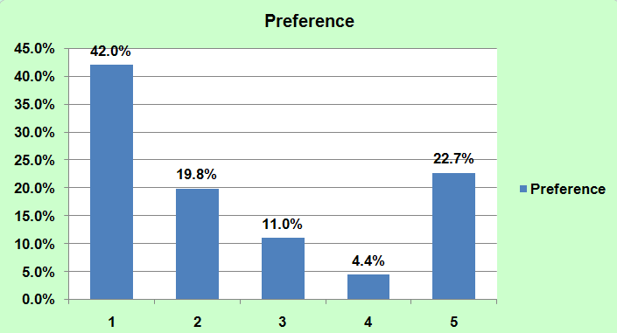
What else should be Improved?
Reduce axis categories & gridlines
Edit title: Preference for what?
Delete Legend (same as Tile)
Reduce decimals
Add Labels: what’s good and what’s bad?
Notes:
Convert to column chart is an improvement, but much more is needed

Slide 80
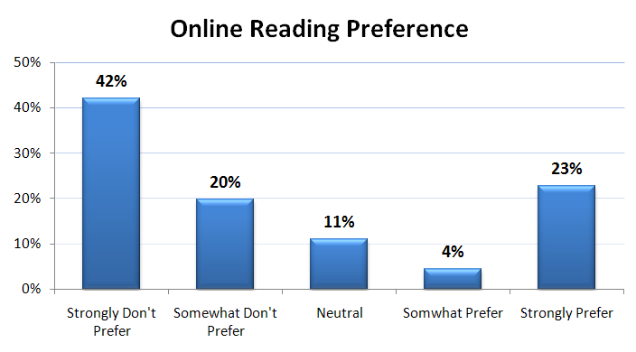
Much Better …
Sample Size: 160
Specify sample size

Slide 81
Creating Visuals in XLDA

Slide 82
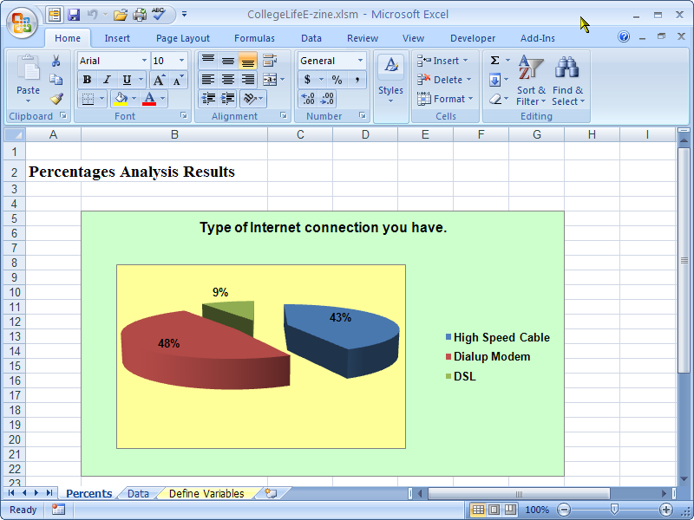
XLDA: Edit Charts
STEP 1: Let XLDA create the initial graph by summarizing percents for a categorical variable.

Slide 83
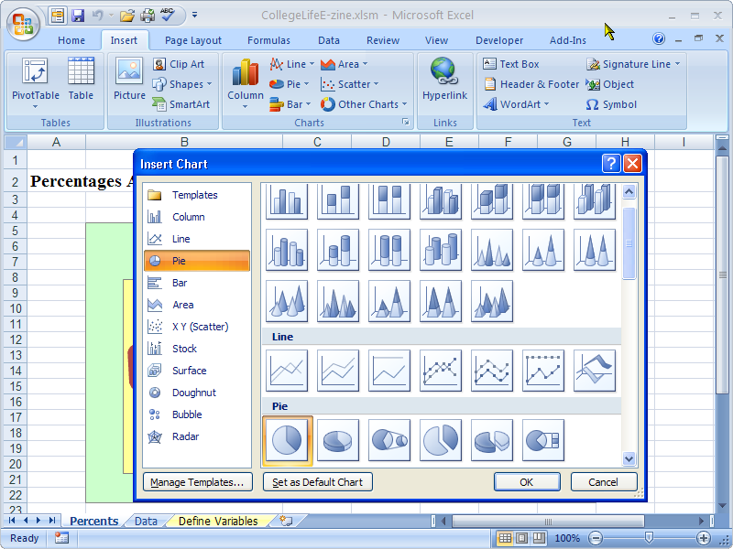
XLDA: Edit Charts
STEP 2: Change the pie chart if you want by clicking on the chart to activate the menu.

Slide 84
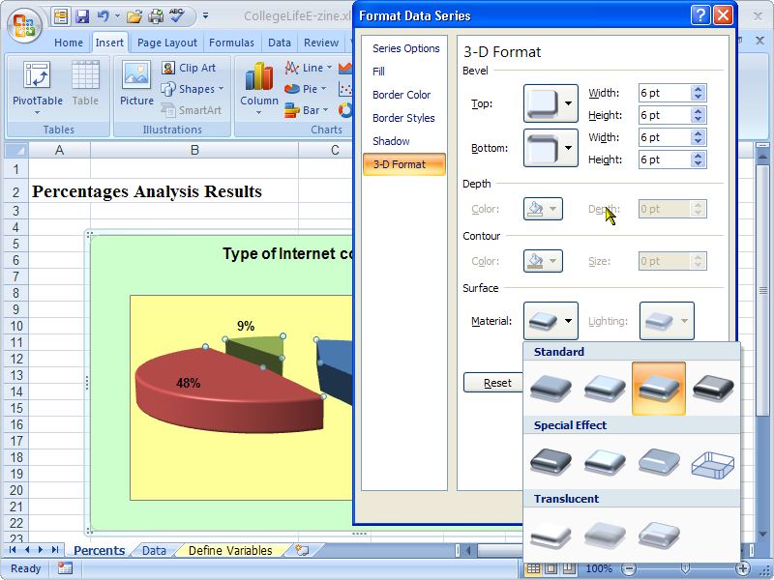
XLDA: Edit Charts
STEP 3: Customize the pie chart.

Slide 85
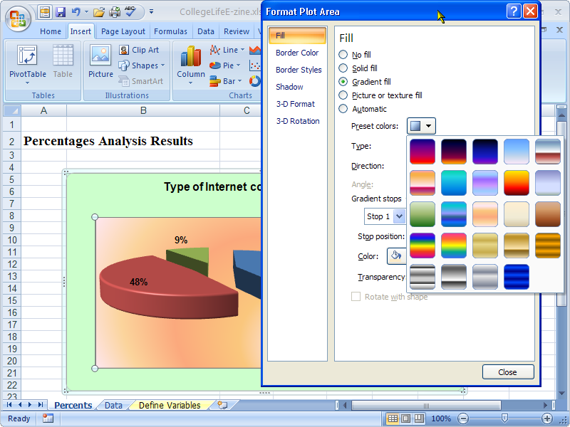
XLDA: Edit Charts
STEP 4: Format the plot area

Slide 86
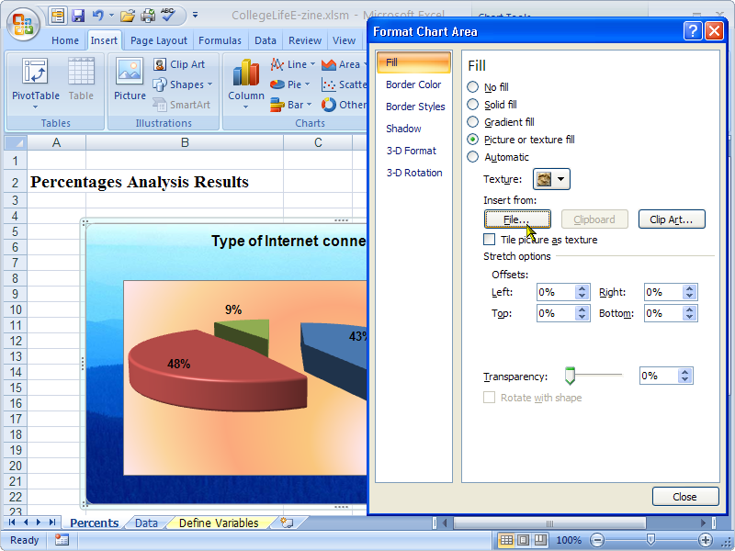
XLDA: Edit Charts
STEP 5: Consider using a picture to personalize your graph.

Slide 87
Type of Question Level of Measurement Type of Analysis

Slide 88
Key Characteristics
Type of Question
Level of Measurement
Type of Analysis

Slide 89
Q Type, Measurement, Analysis
Please indicate your academic classification:
Freshman
Sophomore
Junior
Senior
Grad Student
Type of Question: | Single Response
Measurement: | Categorical
Analysis: | Percent

Slide 90
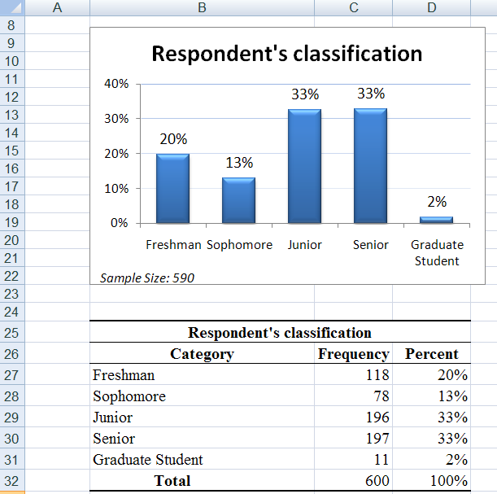
Summarize: Percent
Single Response
Categorical
Chart in Report
Table in Appendix

Slide 91
Q Type, Measurement, Analysis
41. What is your GPA? ____________
Type of Question: | Single Response
Measurement: | Metric
Analysis: | Average

Slide 92
Summarize: Average
Single Response
Metric
Table in Appendix
No Chart for this analysis.
Just comment on Average and potentially
on the Standard Deviation in the report.

Slide 93
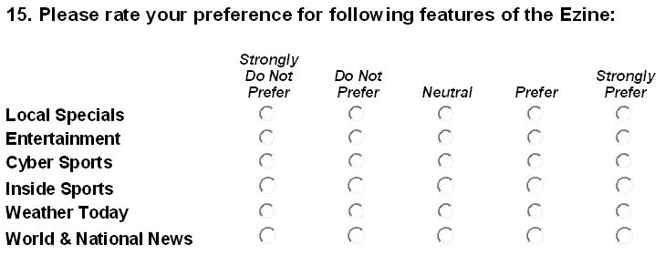
Q Type, Measurement, Analysis
Type of Question: | Grid
Measurement: | Metric
Analysis: | Compare Average

Slide 94
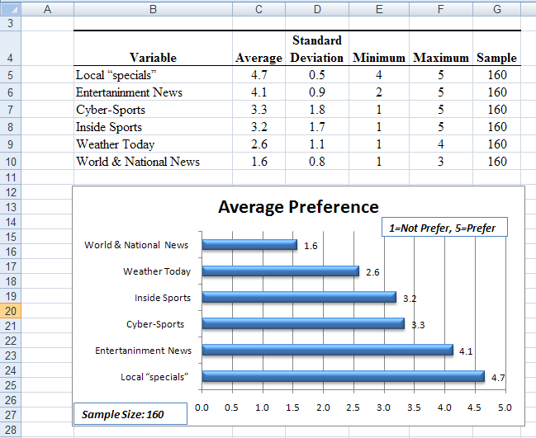
Grid Questions
Table in Appendix
Chart in Report

Slide 95
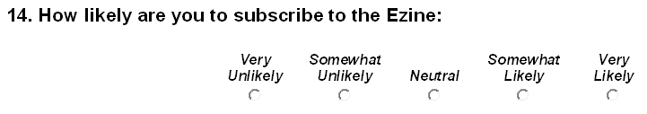

Q Type, Measurement, Analysis

Slide 96
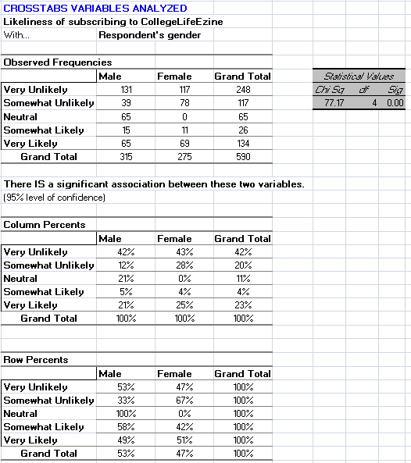
Crosstabs
Copy all Tables
into Appendix.
Make sure to incl.
the grey sig table.
Copy Col. Pct.
table into Report
(or create a visual
of the Col. Pct. Table
for the report).
Remember a title!

Slide 97

Q Type, Measurement, Analysis
Type of Question: | Multiple Response Qs
Measurement: | Categorical (0,1)
Analysis: | SNAP: Crosstabs

Slide 98

Producing Tables in Snap
Choose Variables to display the list of variables (=questions).

Slide 99
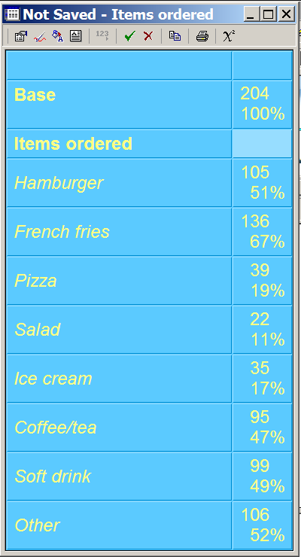
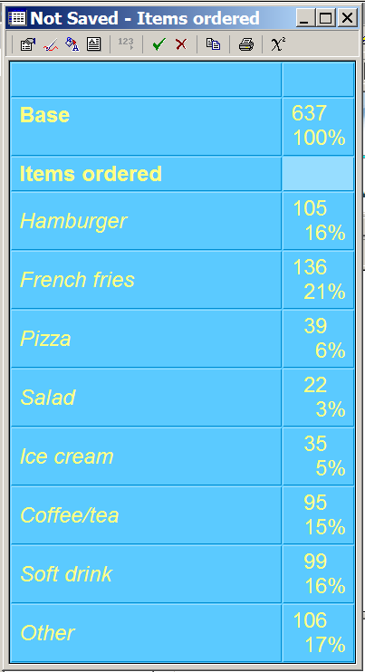

Multiple Response in Snap
You can choose to display the frequency base as:
Respondents
Responses
To switch base click

Slide 100
Multiple Response Qs
Analysis in Snap (See PC Lab Wk 6&7).
Both tables in the Report (if relevant).

Slide 101
Review Visuals!
Visuals:
Several types of visuals; choose visuals that are appropriate for the data.
Use visuals as much as possible in the Report.
Place tables in the Appendix (remember headings).
Crosstabs are often better kept just a Percent Table in the report.
Analysis:
XLDA: Single Response, Grid, Crosstabs
Snap: Multiple Response

